Slide 1


SAP Cloud Integration
Training
ON THE
SAP BUSINESS TECHNOLOGY PLATFORM
Date: Jan 9th, 2023
Time: 9:00AM IST
Facilitator: Anu
www.anubhavtrainings.com

Slide 2

Introduction to SAP BTP
On premise v/s Cloud offerings
Integration
What cloud offers
What is SAP BTP?
What BTP offers broadly – Environment, Subscriptions and Instances
BTP Service Catalogs
BTP setup
www.anubhavtrainings.com

Slide 3
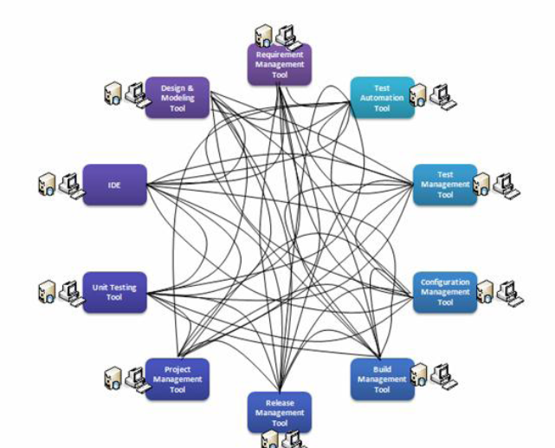

Integration
OLD INTEGRATION
www.anubhavtrainings.com
Notes:
https://help.sap.com/docs/BTP/65de2977205c403bbc107264b8eccf4b/144e1733d0d64d58a7176e817fa6aeb3.html

Slide 4
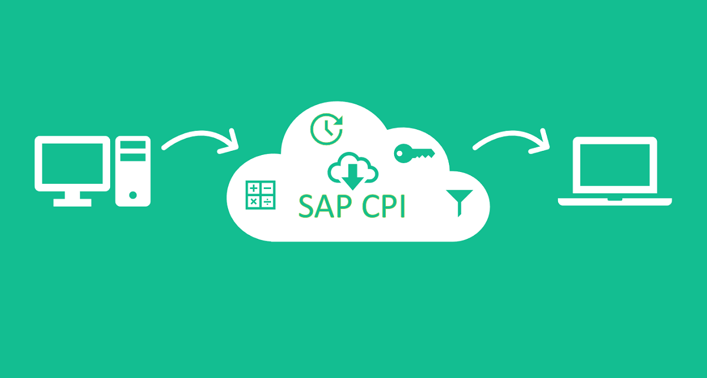
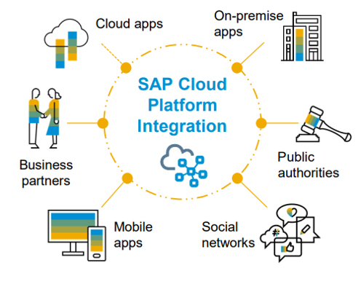
SAP Cloud Integration
OLD ITEGRATION
www.anubhavtrainings.com
Notes:
https://help.sap.com/docs/BTP/65de2977205c403bbc107264b8eccf4b/144e1733d0d64d58a7176e817fa6aeb3.html

Slide 5

SAP Cloud Integration
CASE 1
Source
Target
<Root>
<Name>Dummy</Name>
</Root>
OLD ITEGRATION
{
"Root": {
"Name": "Dummy"
}
}
www.anubhavtrainings.com
Notes:
https://help.sap.com/docs/BTP/65de2977205c403bbc107264b8eccf4b/144e1733d0d64d58a7176e817fa6aeb3.html

Slide 6
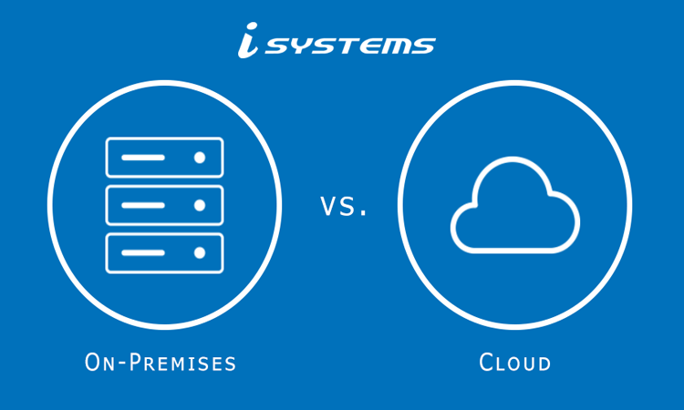
System
www.anubhavtrainings.com
Notes:
https://help.sap.com/docs/BTP/65de2977205c403bbc107264b8eccf4b/144e1733d0d64d58a7176e817fa6aeb3.html

Slide 7
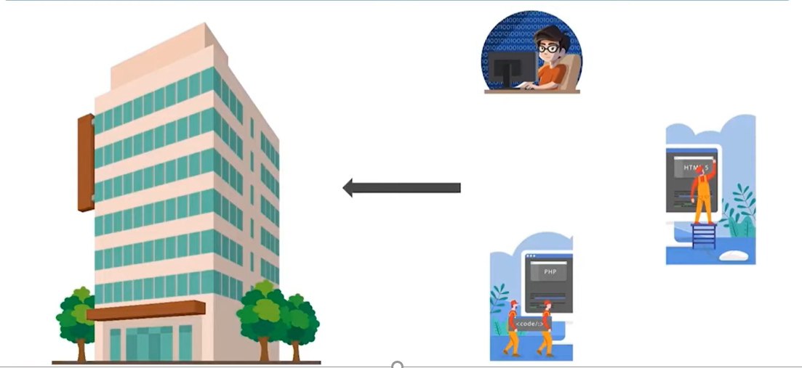
ON premise Architecture ON premise Architecture On premise Architecture
www.anubhavtrainings.com
Notes:
https://help.sap.com/docs/BTP/65de2977205c403bbc107264b8eccf4b/144e1733d0d64d58a7176e817fa6aeb3.html

Slide 8
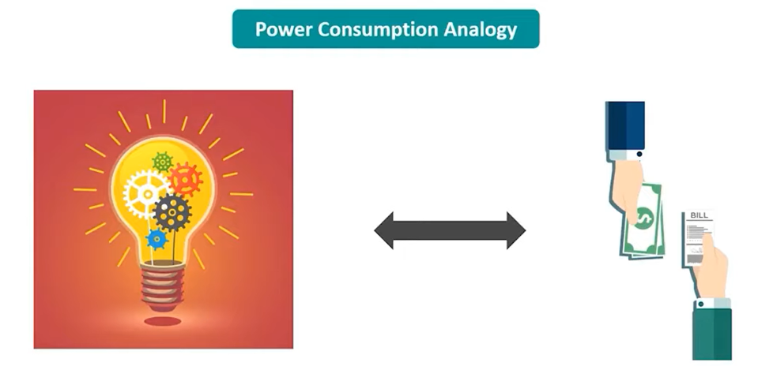
Cloud Computing
www.anubhavtrainings.com
Notes:
https://help.sap.com/docs/BTP/65de2977205c403bbc107264b8eccf4b/144e1733d0d64d58a7176e817fa6aeb3.html

Slide 9
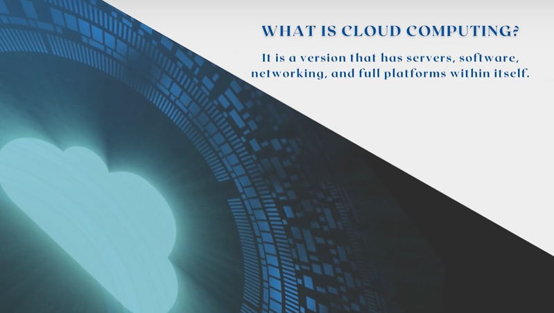
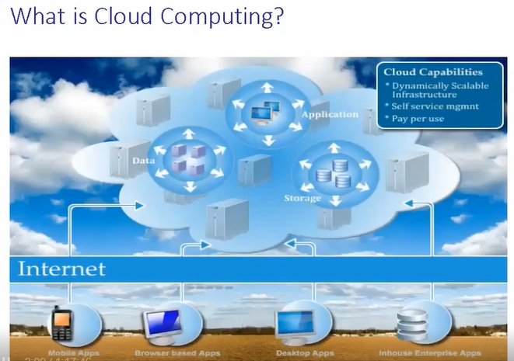
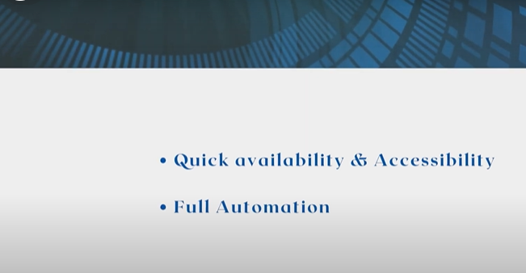
Cloud Computing
www.anubhavtrainings.com
Notes:
https://help.sap.com/docs/BTP/65de2977205c403bbc107264b8eccf4b/144e1733d0d64d58a7176e817fa6aeb3.html

Slide 10
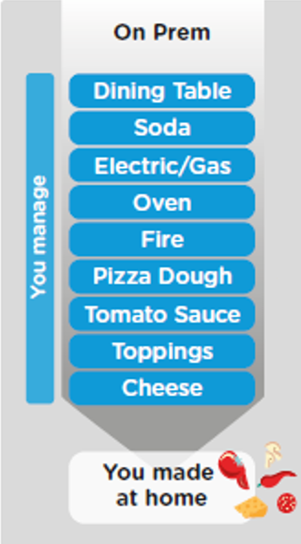
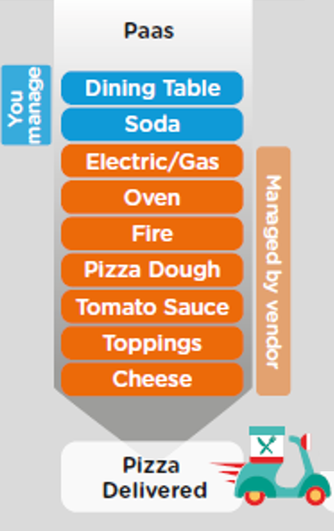
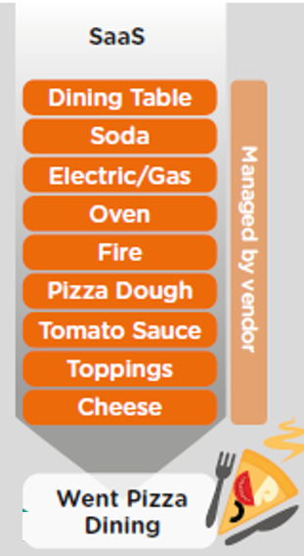
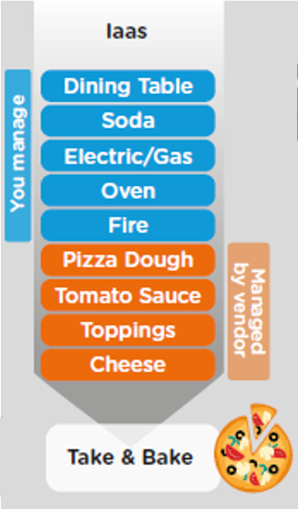
On Premise V/s Cloud
www.anubhavtrainings.com

Slide 11
Cloud Offerings
Content
Application
Application As a Service
Customer Managed
Customer Managed
Customer Managed
SAP Managed
Data
Runtime
Platform as a Service
SAP/Partner Managed
Middleware
Database
OS
Virtualization
Infrastructure as a Service
SAP/Partner Managed
Servers
Storage
Networking
www.anubhavtrainings.com

Slide 12
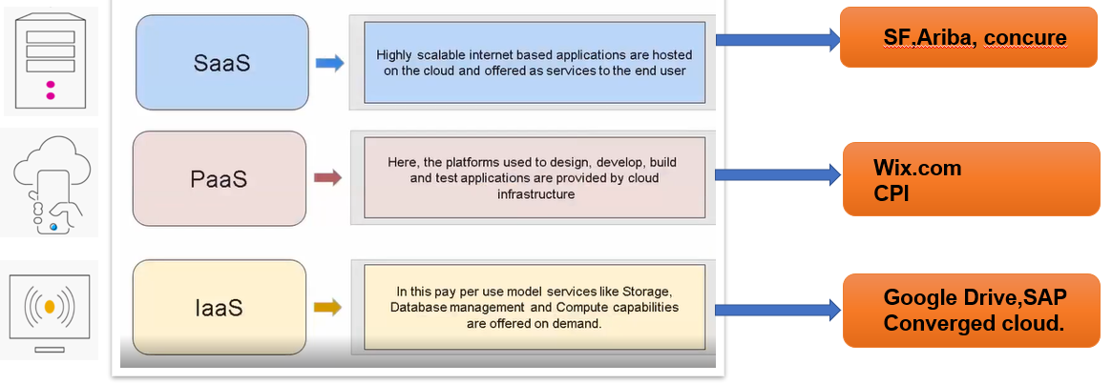
Cloud Computing Models
www.anubhavtrainings.com

Slide 13




What is BTP
Application
Application
Data
Data
Runtime
Platform as a Service
Managed by SAP implementing open source CF
Middleware
Fully ready landscape with reusable services
Scalability
Elasticity
Low TCO
Database
OS
Managed by Infrastructure
providers
Data Centers
Service Portfolio
Virtualization
Infrastructure as a Service
Servers
Storage
Networking
www.anubhavtrainings.com

Slide 14
Environment, Subscriptions & Instances
Environments
Environments constitute the actual platform-as-a-service offering of SAP BTP that allows for the development and administration of business applications. Environments are anchored in SAP BTP on subaccount level.
SAP BTP offers three environments: ABAP, Cloud Foundry and Kyma. Some existing customers still have Neo, but this is no longer offered.
Subscription based services
You will also see these ones called software as a service (SaaS), or multitenant applications. The experience here is that you subscribe to the service, and in return you receive a URL, from which you can access that service. Opening the URL brings you to a web application from which you can leverage the service. This is how other SaaS like SuccessFactors or S/4HANA Cloud work as well. They are also enabled at a subaccount level, and are independent of the environments. You don’t need to have Cloud Foundry enabled to subscribe to SAP Launchpad Service, for example.
Examples include Launchpad, SAP Business Application Studio, Cloud Integration, Process Automation…
Instance based services
These are the purest services. They provide a specific functionality, like databases, connectivity, authentication…. You connect your application to them to leverage that functionality. These services don’t provide a UI to manage them. Instead, they rely on API to connect to applications and other services and provide their services. They are provisioned inside an environment, so they are environment specific. Each environment has its own organization (for users and applications): In Cloud Foundry, instances are created inside a space. For Kyma, instances are created inside a namespace.
www.anubhavtrainings.com
Notes:
https://help.sap.com/docs/BTP/65de2977205c403bbc107264b8eccf4b/144e1733d0d64d58a7176e817fa6aeb3.html

Slide 15
BTP Account Administration
Backing Services
Global Account
(Representation of customer for billing purpose)
Sub Account
(per region)
Specialized service offerings
Represents LoB
Space quotas
1 *
1 *
Space
1
*
Apps
www.anubhavtrainings.com
Notes:
https://help.sap.com/docs/BTP/65de2977205c403bbc107264b8eccf4b/8ed4a705efa0431b910056c0acdbf377.html

Slide 16
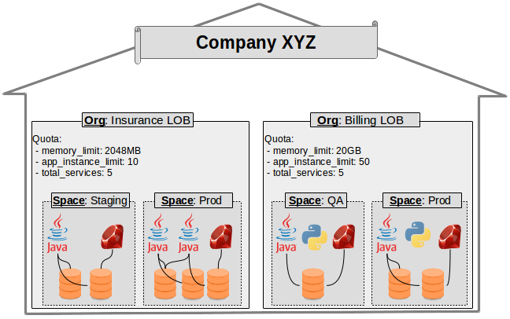
Customer’s eye view
Content
www.anubhavtrainings.com

Slide 17
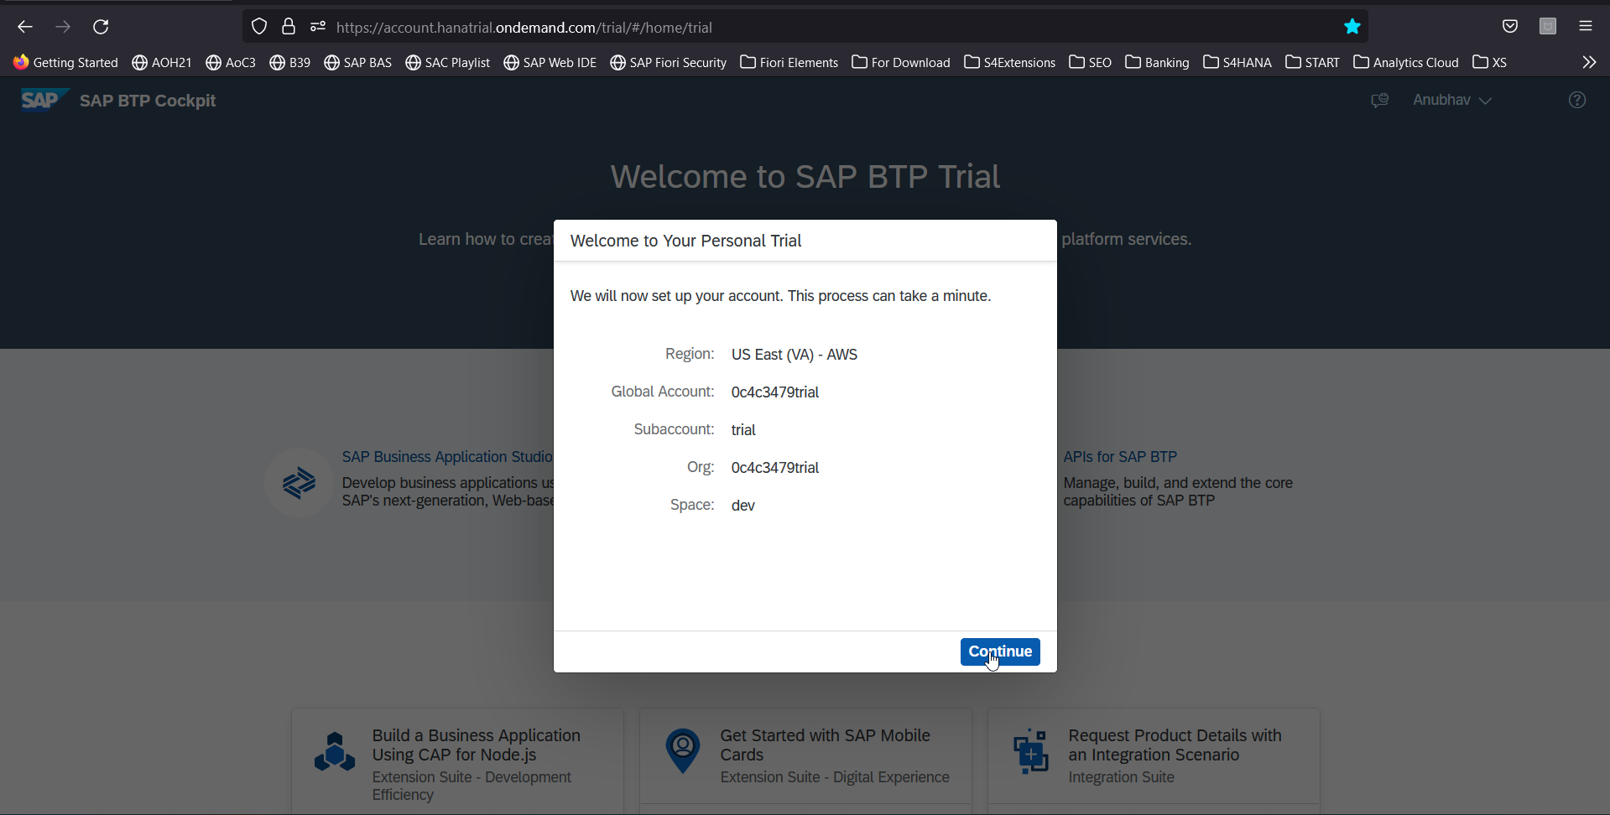
FAQ’s
Create your free BTP Account
https://account.hanatrial.ondemand.com/trial/#/home/trial
www.anubhavtrainings.com

Slide 18
SAP CPI Advantage
No maintenance
Less implementation time
Rolling software updates
Tenant Isolation
Light weight nature of CPI may be used in future for mobile based communication
Migration from SAP PI to SAP CPI
www.anubhavtrainings.com

Slide 19
SAP CPI vs PI
Cost
Availability
Prepackage
Support
Latest innovation
System setup
System Support
Latest updates
Monitoring
Data storage
Adapters
connectivity
www.anubhavtrainings.com

Slide 20
Integration Suit
Difference between Integration Suit and SAP CI

Slide 22
Integration Suit
SAP Integration Suite connects and contextualizes processes and data while enabling new content-rich applications to be assembled faster with less dependence on IT. Pre-built integration packs along with existing investments can be composed to deliver new outcomes with less involvement by integration experts
This service runs in the SAP BTP, Cloud Foundry environment.

Slide 23
Integration Suit
Features:
Design and operate integration scenarios
Design, develop, and manage APIs
Enable connectivity of applications
Use integration packs
Simplify mapping implementation
Manage integrations with trading partners

Slide 24
Integration Suit
Capabilities
Cloud Integration- Integrate SAP and non-SAP, cloud, and on-premise applications and process messages in real-time scenarios spanning different companies, organizations, or departments within one organization
API Management
Open Connectors
ntegration Advisor
Trading Partner Management
Integration Assessment

Slide 25
What is CPI
Support end-to-end process integration through the exchange of messages.
SAP Cloud Integration helps you to connect cloud and on-premise applications with other SAP and non-SAP cloud and on-premise applications.
This service has the capabilities to process messages in real-time scenarios spanning different companies, organizations, or departments within one organization.

Slide 26
Features
Implement diverse scenarios
Connect to multiple endpoints
Customize SAP integration scenarios
Develop custom adapters
Access public APIs
Set up secure and reliable communication
Implement various communication modes
Integrate with SAP Process Orchestration

Slide 27
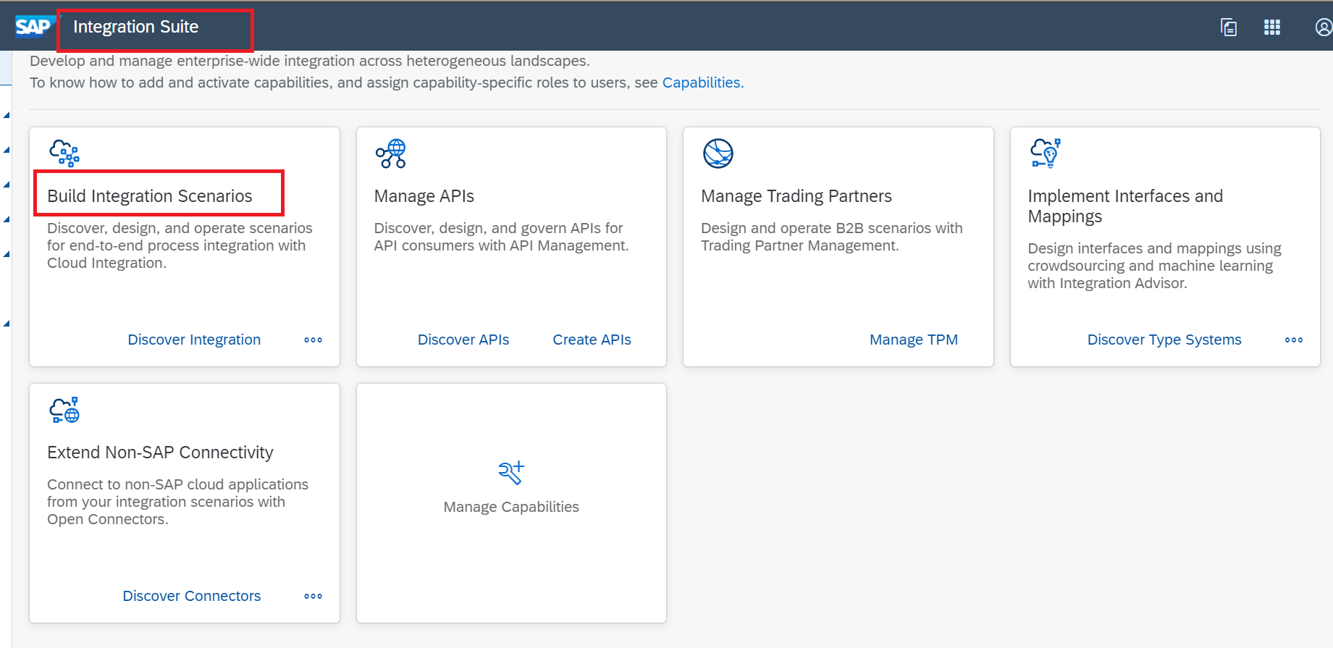
INtegraion Suit and SAP CI

Slide 28
Setup BTP TRAIL Account
In your web browser, open the SAP BTP trial cockpit- https://account.hanatrial.ondemand.com/

Slide 29

Navigate to the trial global account by choosing Go To Your Trial Account.

Slide 30
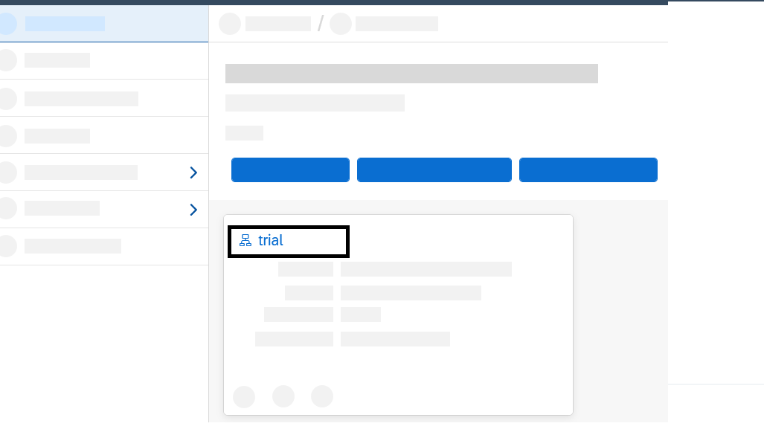
From your global account page, choose the appropriate subaccount’s tile to navigate

Slide 31
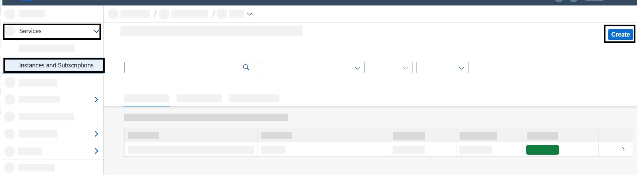
Select Services > Instances and Subscriptions.
Choose Create.

Slide 32
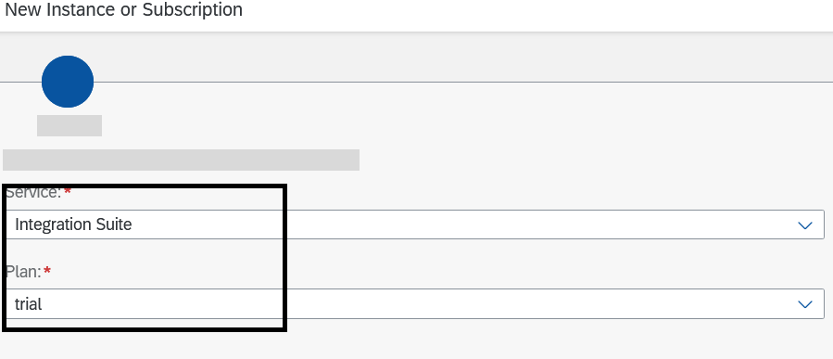
In the New Instance or Subscription dialog, choose Integration Suite from the list of services
Choose the default plan which is trial and then choose Create. You are subscribed to the service now

Slide 33
Select Security > Users. Choose the entry against your name. In the Role Collections section, choose Assign Role Collection

Slide 34
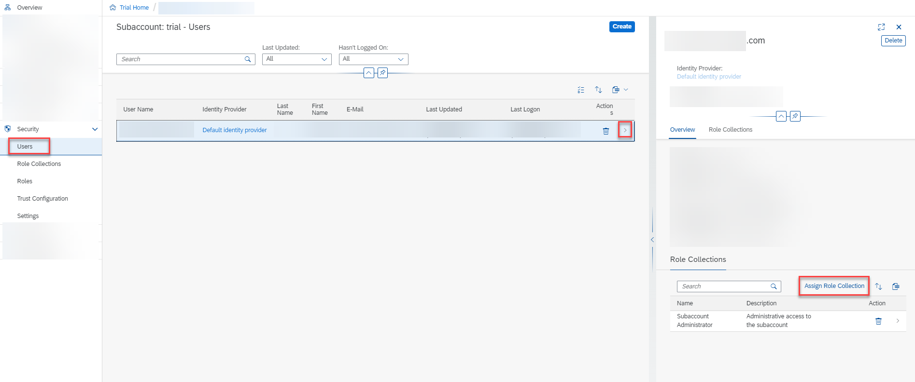

Slide 35
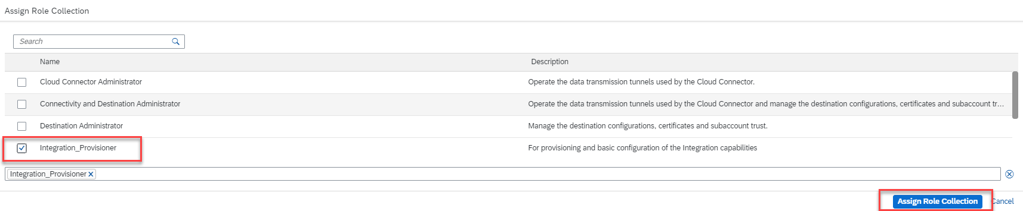
In the dialog that appears, select Integration Provisioner. Choose Assign Role Collection.

Slide 36
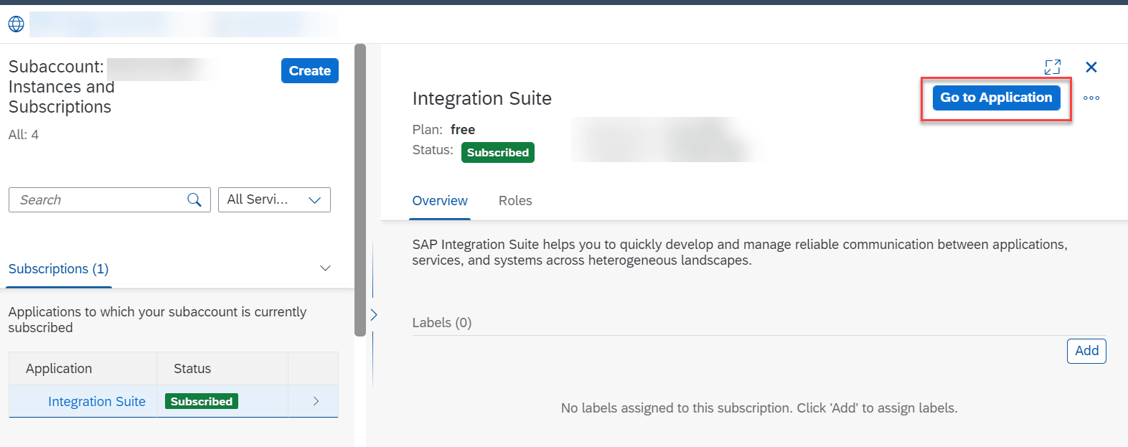
Click Go to Application in the Integration Suite overview page. Now you are directed to the Integration Suite home page.

Slide 37
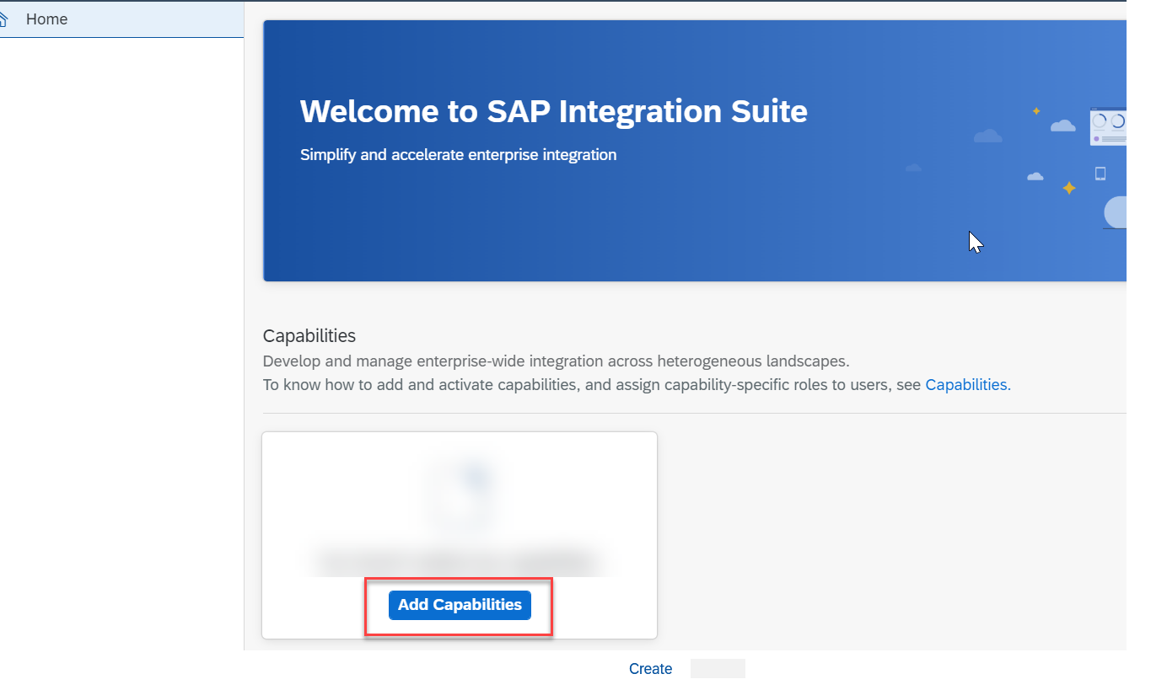
In the Integration Suite home page, choose Add Capabilities to activate the capabilities offered by Integration Suite.

Slide 38
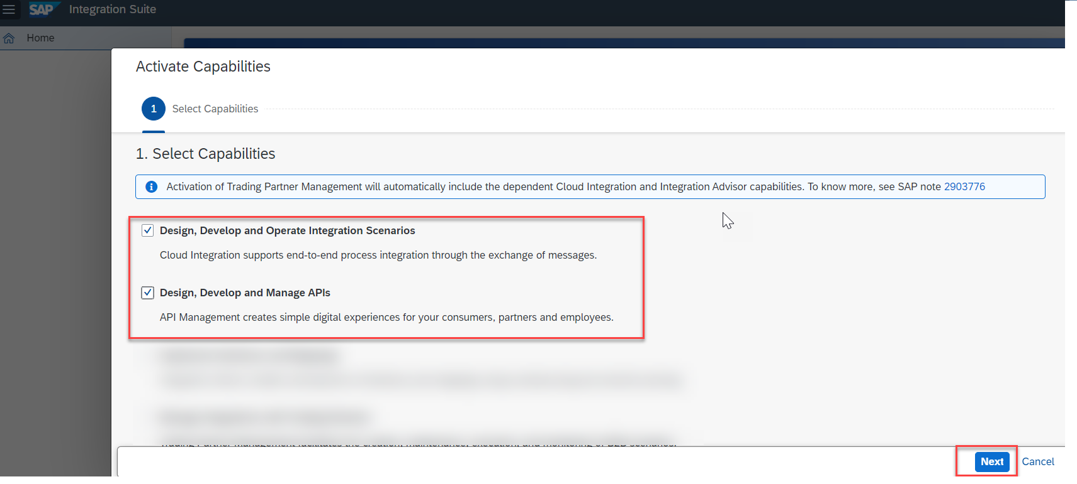
For this tutorial, you must select the Design, Develop and Operate Integration Scenarios and Design, Develop and Manage APIs click capabilities. Choose Next.

Slide 39
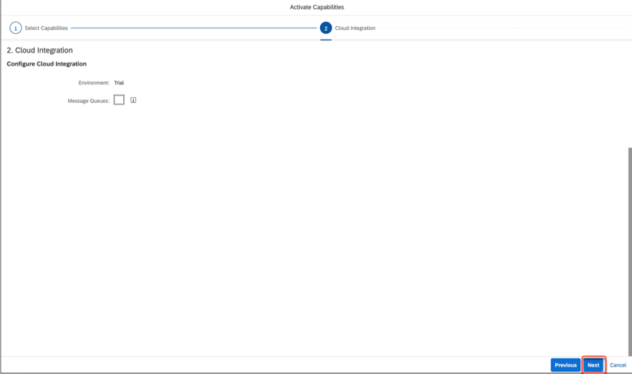
Choose Next.

Slide 40
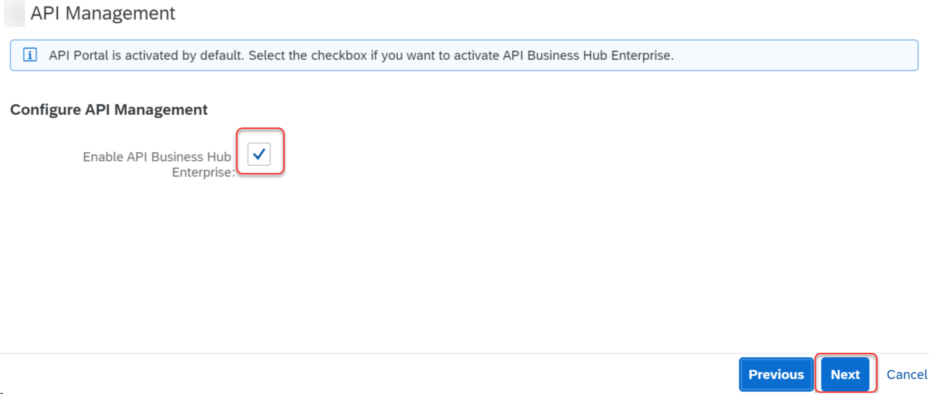
Select the Enable API Business Hub Enterprise checkbox. Choose Next.

Slide 41
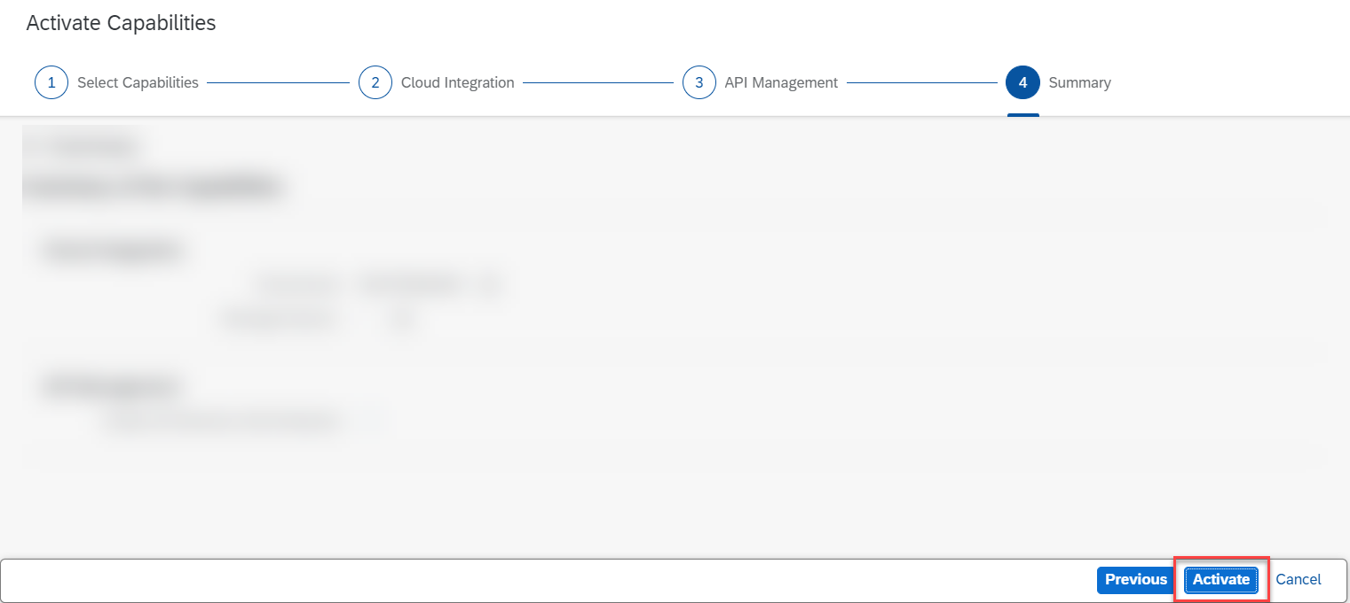
Choose Activate to provision the selected capabilities.

Slide 42
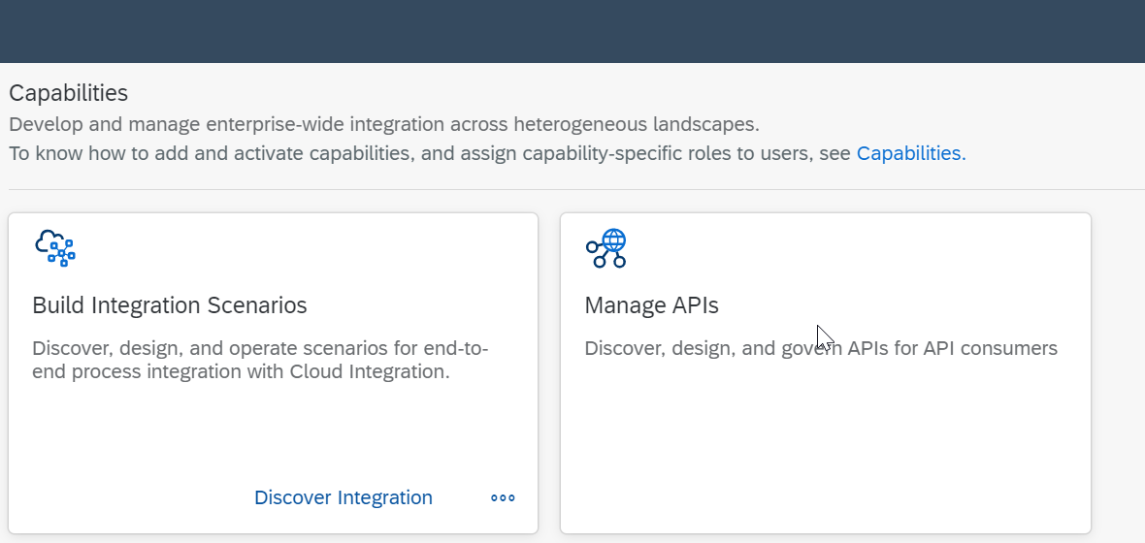

Slide 43
Automatically assign roles and create service instances using Booster
Navigate to the overview page of your SAP BTP global account.
Choose Boosters on the left navigation pane
From the list of boosters, look out for the tile Enable Integration Suite. You can start the booster execution by choosing Start on the tile.

Slide 44
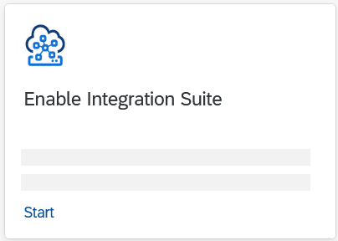

Slide 45
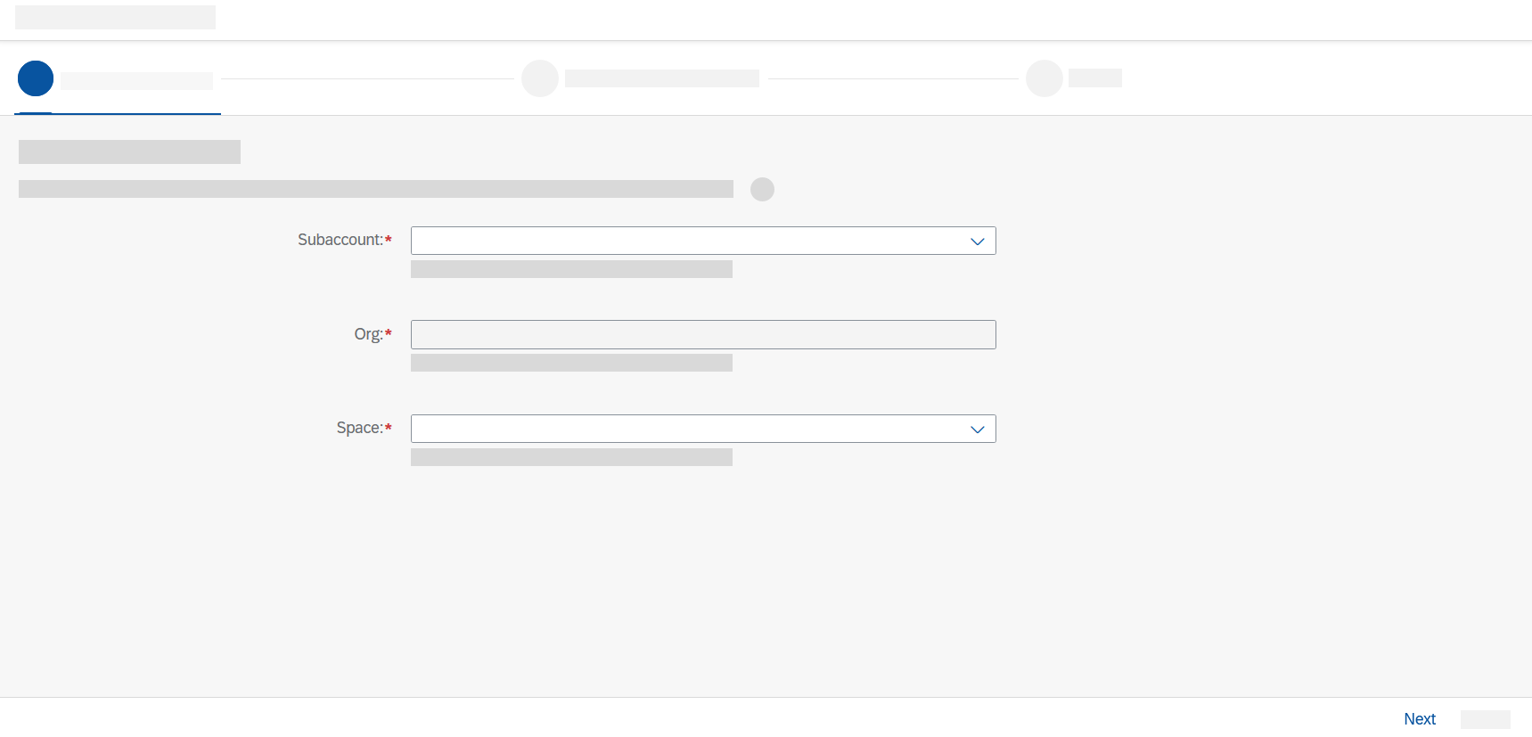
In the Configure Subaccount tab, select your subaccount, organization, and space in which you have subscribed for Integration Suite service. Choose Next.

Slide 46
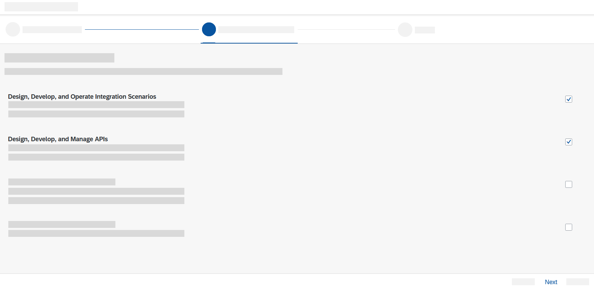
In the Select Activated Capabilities tab, select Design, Develop, and Operate Integration Scenarios and Design, Develop, and Manage APIs. Choose Next.

Slide 47
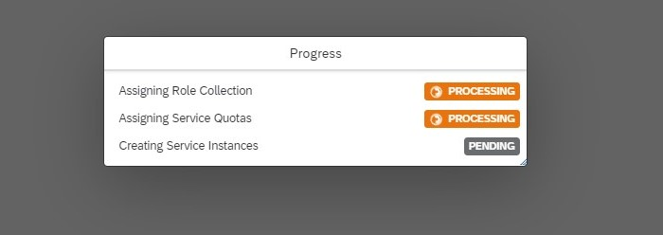
In the Review tab, check your selections and choose Finish. You can see that the booster is being processed.

Slide 48
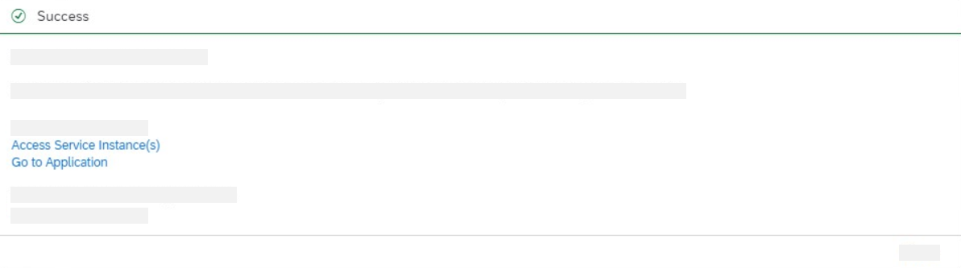
Upon successful execution of the booster, choose Go to Application. Also, choose Access Service Instance(s) to view the service instance and service key.

Slide 49
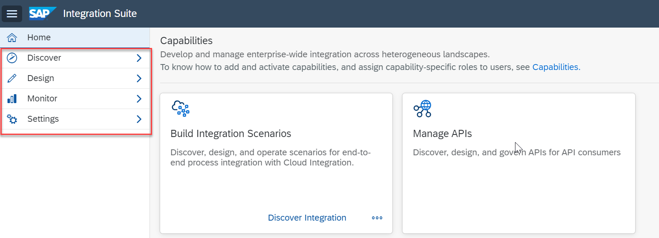
Verify the activated capabilities

Slide 50
QnA
Difference Between IS and CI
Difference Between PI/PO and CPI
Difference between Onpremise and Cloud

Slide 51
Thank You

